Slide 1




Sierra Club
Air Quality Analysis
Team EJ Warriors:
Bush, Chi, Manling, & Kaitlyn

Slide 2
1
AGENDA
01
Our Team & Project
02
Reasoning & Resources
03
Analysis Overview
04
Interactive Dashboard
05
Findings & Limitations
06
Recommendations

Slide 3





MEET OUR TEAM
2
GUANGXIN BAO
Client Liaison
Fav Food:
CHIOKE BELLAMY
Advisor Liaison
Fav Food:
MANLING SHI
Research Lead
Fav Food: Takoyaki
KAITLYN VICKERS
Team Lead
Fav Food: Chocolate covered Pretzel
Our Team Project
Reasoning & Resources
Analysis Overview
Interactive Dashboard
Findings & Limitations
Recommendations

Slide 4


The Sierra Club
3
American environmental non-profit organization
One of the world's earliest environmental preservation groups, known for advocating sustainable energy and climate justice
Environmental Justice
Historically, certain communities (low income, racially diverse communities) suffer greater pollution, and the quest for environmental justice is to ensure that everyone, regardless of socioeconomic status has equal access to a healthy environment.
Our Team Project
Reasoning & Resources
Analysis Overview
Interactive Dashboard
Findings & Limitations
Recommendations

Slide 5
4
WHY AIR QUALITY MATTERS?
According to the 2023 World Air Quality Report:
2023 World Air Quality Report. (n.d.). https://www.iqair.com/dl/2023_World_Air_Quality_Report.pdf.
1 in every 9 deaths
7 million premature deaths / year
Can cause and worsen health issues (Asthma, Cancer, Diabetes, et al.)
Cognitive Development in Children
Our Team Project
Reasoning & Resources
Analysis Overview
Interactive Dashboard
Findings & Limitations
Recommendations

Slide 6




KEY QUESTIONS
5
ARE THERE KEY DIFFERENCES IN AIR QUALITY (PM2.5) BETWEEN EJ COMMUNITIES AND NON-EJ COMMUNITIES?
FURTHER QUESTIONS
How do we efficiently acquire air quality data?
How do we best visually show air quality differences from EJ to Non-EJ?
How do we best test for significance in air quality differences?
What further relationships will cause the difference in air quality within the two areas?
Our Team Project
Reasoning & Resources
Analysis Overview
Interactive Dashboard
Findings & Limitations
Recommendations

Slide 7



6
Purple Air
PurpleAir is a network of air quality sensors providing real-time data on pollution levels, enabling communities to monitor and respond to environmental conditions.
Our Team Project
Reasoning & Resources
Analysis Overview
Interactive Dashboard
Findings & Limitations
Recommendations

Slide 8
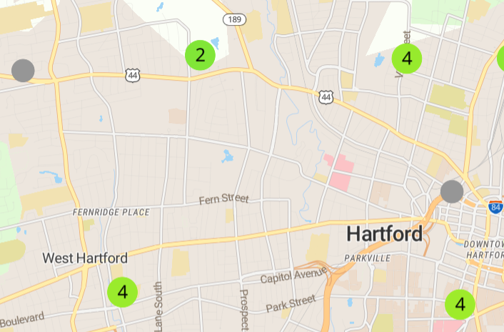
4 Sensors Chosen:
EJ Sensors (Hartford):
Hartford City Mission (51011)
BiCi Co Park (178869)
Non-EJ Sensors (West Hartford):
Ledyard (109684)
Kingswood Oxford School (142606)
EJ Map 2023
7
Ledyard Sensor (Sensor #: 109684):
In less populated area of West Hartford
Residential
Non – EJ community
Hartford City Mission Sensor
(Sensor #: 109684):
Christian non-profit focused on helping local youth
In Hartford’s North End
EJ community
Kingswood Oxford School Sensor (Sensor #: 109684):
Middle school in West Hartford Center
Non – EJ community
BiCi Co Park Sensor
(Sensor #: 109684):
Bicycle shop - Part of the Center for Latino Progress (non-profit)
Closer to downtown and near highway
EJ community

Slide 9

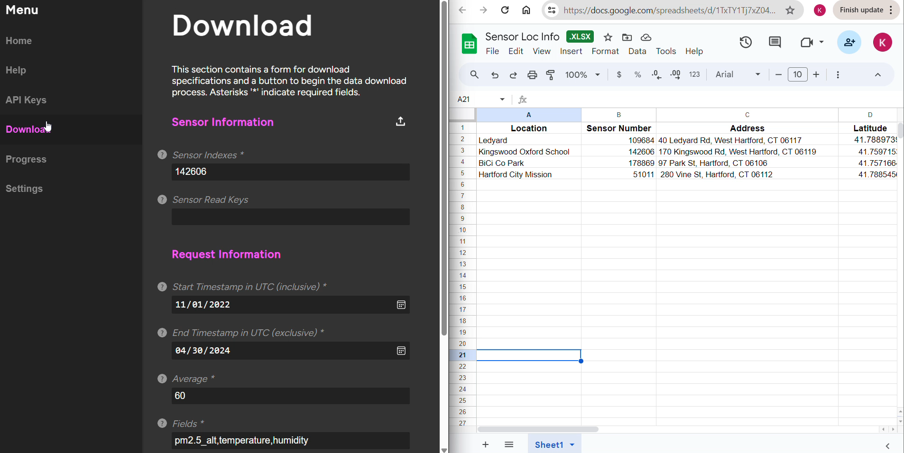
8
DATA DOWNLOAD TOOL
Steps to Data Download:
Create a Read API Key on Purple Air Develop
Download Purple Air Download Tool
Input Sensor, Time Frame, Data Frequency, and Metrics of Interest and Download!
Our Team Project
Reasoning & Resources
Analysis Overview
Interactive Dashboard
Findings & Limitations
Recommendations
Notes:
Note PM2.5 stands for Particulate Matter 2.5 and the units are microgrammes per cubic meter (mu*g/m^3)

Slide 10




9
OUR DATA
Size
13106 entries across 19 different metrics
Time Frame
Earliest: 10-31-2022
Latest: 4-29-2024
Metrics
Time Stamp, PM2.5, and Location
Feature Engineering
Created 16+ new temporal based features
Our Team Project
Reasoning & Resources
Analysis Overview
Interactive Dashboard
Findings & Limitations
Recommendations

Slide 11



10
ANALYSIS BREAKDOWN
1. Clean Data
2. Create New Features
3. Exploratory Analysis
4. Pair Data and Take Differences
6. Bring it all together
6. Dashboard Creation
5. Statistical Tests
Our Team Project
Reasoning & Resources
Analysis Overview
Interactive Dashboard
Findings & Limitations
Recommendations

Slide 12
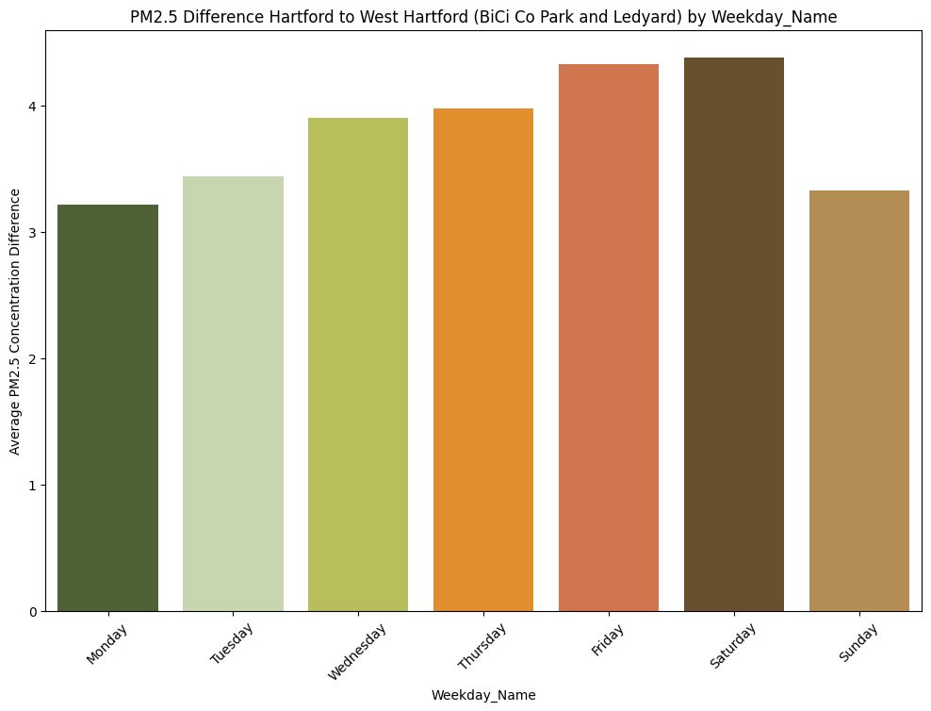
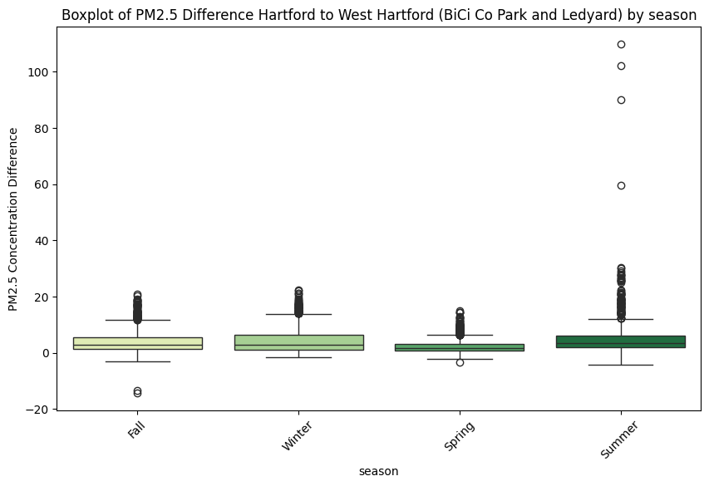
11
INTERESTING FINDINGS
Hartford (EJ) > West Hartford (Non-EJ) | BiCi Co Park > Hartford City Mission | Kingswood Oxford > Ledyard
Our Team Project
Reasoning & Resources
Analysis Overview
Interactive Dashboard
Findings & Limitations
Recommendations

Slide 13

INTERACTIVE DASHBOARD DEMO
12
Our Team Project
Reasoning & Resources
Analysis Overview
Interactive Dashboard
Findings & Limitations
Recommendations

Slide 14

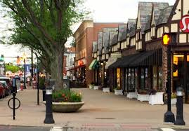
13
SIGNIFICANT FINDINGS
EJ has a significantly higher pm2.5 level in Hartford (EJ) than West Hartford (non-EJ)
Every sensor has a significant difference with every other sensor (much stronger EJ vs non EJ)
Key Differences
Notable Findings
Biggest Difference: City Mission vs. Ledyard: (t=91.70, p < 0.001)
Temporal Insights
Air quality difference much worst in December; best in March
Lower PM2.5 in Spring; higher in Summer & Winter
Mornings have the biggest difference based on time of day, but no significant difference during rush hour
Need for targeted air quality interventions in Hartford's EJ communities.
Our Team Project
Reasoning & Resources
Analysis Overview
Interactive Dashboard
Findings & Limitations
Recommendations

Slide 15

14
LIMITATIONS
Data pull will eventually cost $
Limited sensors
Only Hartford and West Hartford
Missing Data
Newer Sensors (Less Historical Data)
Database contains two data sets
Our Team Project
Reasoning & Resources
Analysis Overview
Interactive Dashboard
Findings & Limitations
Recommendations

Slide 16








15
Next Steps
Utilize Dashboard
Finish Continuous Data Pull Code
Consider Other Metrics
Partner with Purple Air
Influence EJ Initiatives
Our Team Project
Reasoning & Resources
Analysis Overview
Interactive Dashboard
Findings & Limitations
Recommendations

Slide 17

Thank you
for listening
Don't hesitate to ask any questions!

